Slide 1
ITIL
Framework

Slide 2
ITIL Framework
The ITIL has the following components:
ITIL Core: Publications describing generic best practice that is applicable to all types of organisation that provide services to a business.
ITIL Complementary Guidance: A set of publications with guidance specific to industry sectors, organisation types, operating models and technology architectures.

Slide 3
THE ITIL CORE
ITIL core represents the five ITIL service lifecycle publications.
The five core books cover each stage of the service lifecycle from:
Initial definition and analysis of business requirements in Service Strategy and Service Design,
through migration into the live environment within Service Transition,
to live operation and improvement in Service Operation and Continual Service Improvement

Slide 4
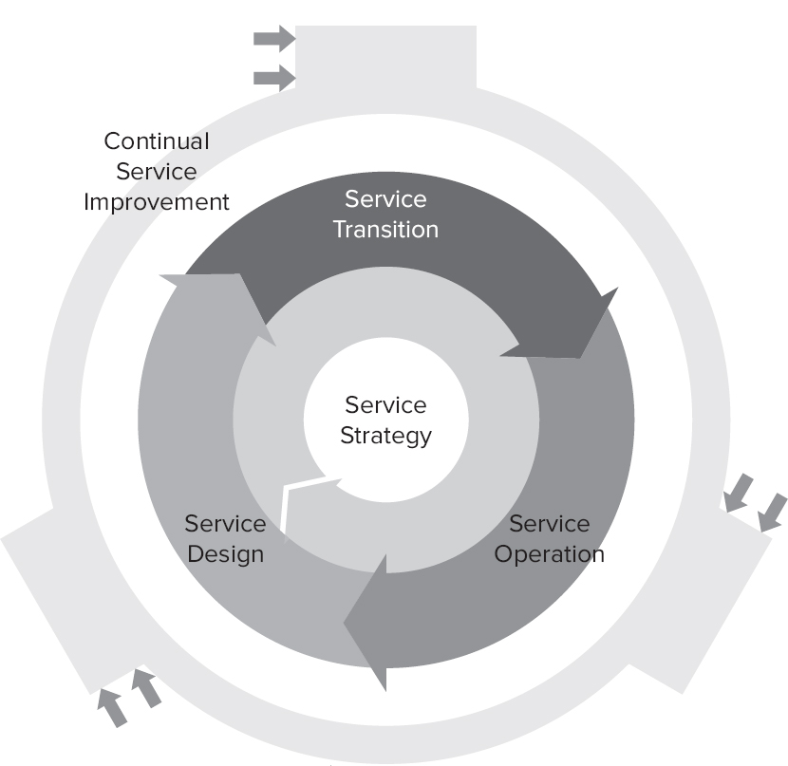
THE ITIL CORE

Slide 5
Service Strategy
KEY PROCESSES in service strategy is:
business relationship management
Financial management for IT services
service portfolio management

Slide 6
Service Strategy
THE FOUR Ps OF STRATEGY
Strategy as a Perspective
Strategy as a Position
Strategy as a Plan
Strategy as a Pattern

Slide 7
SERVICE MANAGEMENT AS A STRATEGIC ASSET
There are two components of service strategy.
Service strategy is about developing strategies for the delivery of specific services.
SS is also about the development of service management.
The development of service management as a strategic asset is central to service strategy.

Slide 8
Service Management
Service management provides the framework within which value is delivered to the customer in the shape of specific services represented collectively in the service catalogue.
The customer's confidence in commissioning new service offerings depends on the service management capabilities of the IT service provider.

Slide 9
Concept: Value creation
Customers must understand service value.
Value is defined by the customer – not the provider
An affordable mix of features needs to be on offer for the customer to want a service
Value might not be measured in financial terms alone – the customer might value a service because it fulfils an ethical or moral objective
Value changes over time.
The customer must see service value as outweighing service cost. IT needs to articulate what:
Services it provides
The services achieve
The services cost.

Slide 10
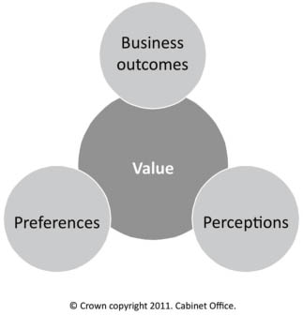
Components of value

Slide 11
Concept: Value creation
Value is influenced by:
Outcomes achieved – does the service support the customer as intended?
Customer preferences – how do these affect the service?
Customer perceptions – are these influenced by any other areas, such as supplier reputation?

Slide 12
STRATEGIC ASSET
Strategic assets are assets that provide the basis for core competence, distinctive performance, durable advantage, and qualifications to participate in business opportunities.
IT organisations can use the guidance provided by ITIL to transform their service management capabilities into strategic assets.

Slide 13
DEVELOPING STRATEGY FOR SPECIFIC SERVICES
A strategy for a specific service offering, the key elements are concerned with a series of activities that involve:
understanding the customer and the ways IT can deliver value to them;
understanding the outcomes the customer wants from the service and how the service will deliver benefit;
defining critical success factors for the service;
developing a specification based on the outcomes required by the customer, including the utility and warranty required;
developing through demand management an understanding of the customer's priorities in relation to patterns of business activity (PBAs).

Slide 14
Service Strategy
The initial, conceptual details of the new service are captured in the service portfolio and the new service begins its journey through its lifecycle.
Through service portfolio management, the new service offering will be put into the broader context of other services.
The business case, developed in conjunction with financial management, will reflect these factors and explain why the service strategy developed represents the best way forward as well as describing how and to what extent it will deliver value.
The outcome of the service strategy process is a decision to continue with the service or not.
Approved services are 'chartered' at which point they are ready to move forward to service design.
The transfer into service design requires the production of a service package, which describes in detail the IT service to be delivered to the customer, including the service levels to be achieved and the supporting services that will underpin its delivery.

Slide 15
SERVICE ASSETS
In delivering a service, the IT service provider exploits its own assets to add value to the customer's assets and generate value for the organisation.
The assets used by the IT service provider can be described in terms of its capabilities and resources. The development of a successful service strategy needs to be built on an understanding of the service assets that can be brought into play in service delivery.
There is no point in formulating a service strategy that requires service assets that will not be available.
Making assumptions about the organisation's ability to improve its service asset base, especially its capabilities, introduces an element of risk that needs to be acknowledged, understood and managed.

Slide 16
Concept: Utility and warranty
Utility and warranty measure value.
Utility: fit for purpose, has required functionality, enhances performance or removes constraints
Warranty: fit for use, includes availability, continuity, security, capacity.
Utility and warranty must both be offered for a service to deliver value.
Utility is what is delivered; warranty is how it is delivered. For example, internet banking utility could include the ability to pay bills online. Warranty could include confidence that information is secure.

Slide 17
SERVICE PACKAGE
A service package is two or more services that have been combined to offer a solution to a specific type of customer need or to underpin specific business outcomes.
A service package can consist of a combination of core services, enabling services and enhancing services.
A service package provides a specific level of utility and warranty.

Slide 18
SERVICE OPTION
A service option is a choice of utility and warranty offered to customers by a core service or service package.
Service options are sometimes referred to as service level packages.

Slide 19
Service Portfolio Management
Purpose and objectives
Ensures the service provider has the right mix of services to meet customer requirements
Tracks investment and return
Defines services and links them to business outcomes, influencing the service lifecycle.

Slide 20
Service Portfolio Management
Objectives:
Provides a process and mechanism to help the service provider decide what services to provide
Maintains a definitive portfolio of services
Provides a mechanism to show how services will support organisational strategy
Controls which services are offered and when
Tracks investment in services
Analyses which services should be retired and when.

Slide 21
Service Portfolio Management
Scope
Includes all services
Ensures the service provider can deliver value through services
Services are linked to business outcomes so investment can be compared to returns
Newer services need to add more value than the services they replace.

Slide 22
Concept: Service Portfolio
Service Portfolio: the full set of services managed by a service provider, including:
Proposed or in development
Live
Retired.

Slide 23
Concept: Service Portfolio
Only services that add value are included in the portfolio.
Service pipeline: services that are being developed – not normally visible to customers
Service catalogue: services that are live, visible to customers
Retired services: services may be retired when they are no longer offered to new customers, or when they are no longer offered to any customers. This is typically because they are no longer useful or profitable.
Third-party services may also be included in the portfolio.

Slide 24
Financial Management for IT Services (FMITS)
Purpose and objectives
Secure funding for service design, development and delivery
Balance cost and quality
Implement a framework to identify, manage and communicate service costs
Evaluate the financial impact of new or changed strategies.
Most organisations have a business Financial Management process.
FMITS needs specialised skills. Practitioners need to understand technology, as well as finance and business. Cost-accounting skills are required to provide detailed management information.
IT financial policies and practices need to follow organisational guidelines to allow IT and other business areas to communicate.

Slide 25
Financial Management for IT Services (FMITS)
Scope
FMITS includes three processes:
Budgeting predicts and controls income and expenditure
Accounting tracks how money is spent
Charging bills customers for services provided (may not apply to all service providers).
Accounting, budgeting and charging have two cycles of activity. On an annual basis, projections and plans are produced. Operationally, costs are monitored and checked, and bills are issued. This normally happens monthly or quarterly.

Slide 26
Business Relationship Management (BRM)
Purpose and objectives
BRM will:
Establish and maintain the customer/service provider relationship
Identify current and future customer needs and make sure they are met.
Objectives include:
Ensuring the service provider understands the customer perspective
Improving customer satisfaction
Identifying changes to the customer environment or technology that could affect services
Establishing and communicating requirements for new or changed services
Implementing a process to manage complaints.

Slide 27
Quiz
Which of the following describes the main way in which the Service Strategy publication can assist an organisation?
To manage strategic relationships within the IT industry
To implement ITIL within an IT organisation
To enable strategic integration with customers and suppliers
To develop service management as a strategic asset

Slide 28
Which of the following statements about the service portfolio are correct?
The service portfolio represents the investments made by a service provider
The service portfolio includes third party services that are part of service offerings
The service portfolio represents the ability of a service provider to serve customers and market spaces
1 and 2 only
All of the above
1 and 3 only
2 and 3 only

Slide 29
What details are contained in the service pipeline?
Operational capability within the context of a market space
The resources engaged in all phases of the service lifecycle
Business requirements that have not yet become live services
Knowledge and information about phased-out services

Slide 30
4 Which of the following statements is/are correct about IT governance?
IT governance is an integral part of enterprise governance
IT governance is the responsibility of the board of directors
IT governance enables organisations to benchmark processes
1 only
1 and 2 only
2 and 3 only
All of the above

Slide 31
5 A business case can be most accurately described as?
A method for tracking business expenditure
A decision support and planning tool
A management tool for business communication
A technique for calculating service valuation

Slide 32
6 From a service management perspective which of the following is NOT a specific risk management activity?
Financial analysis of the likely consequences of a business action
Ensuring processes are in place for ongoing monitoring of risks
Identification and selection of appropriate countermeasures
Having access to reliable and up-to-date information about risks

Slide 33
7 It is important to distinguish between the three different types of service provider. Which of the following most accurately describes the main difference between Type I and Type II service providers?
Type I providers are internal and Type II provide external services
Type I providers are internal and Type II provide shared services
Type I providers are external and Type II provide internal services
Type I providers are technology focused and Type II business focused

Slide 34
8 Value is defined not only in terms of the customer's business outcomes, it is also highly dependent on?
The maturity of the IT processes
Managing the cost of service provision
The customer's perceptions
Effective resource utilisation

Slide 35
9 Which of the following most accurately describes the need for service providers to develop a marketing mindset?
To offer customers a comprehensive service catalogue
To offer competitively priced service offerings
To look at services from the customer's perspective
To utilise a wide range of communication channels

Slide 36
10 'Fitness for purpose' of a service comes from which of the following?
The attributes of the service that have a positive effect on the performance of the business
The ability of a service to remain operational at all times as agreed in an SLA
The ability of a service to provide the required levels of functionality when required
The service being provided by an outsourcing organisation
11 Which of the following is NOT an activity of demand management?
Analysing and tracking business activities related to IT services
Influencing demand for services using pricing incentives
Redesigning business processes to match IT resource constraints
Providing demand forecasts for capacity management

Slide 37
12 Which of the following are potential benefits of analysing patterns of business activity?
Service design can optimise designs to suit business demand patterns
Financial management can approve incentives to influence demand
Service operation can adjust allocation of resources and scheduling
Service portfolio management can prioritise appropriate investments
1 and 3 only
2 and 3 only
1, 2 and 4 only
All of the above

Slide 38
13 How is financial management applicable to the different types of service provider?
Financial management is mostly applicable to external service providers
Financial management is only applicable to Type II and Type III providers
Financial management is less applicable for internal service providers
Financial management is equally applicable to Type I, II and III service providers
14 A goal of financial management is to ensure proper funding for the delivery of services. What is the main way in which this is achieved?
Introducing charging in order to generate required revenue and profit
Financial analysis and qualification of the future demand for IT services
Establishing mature accounting practices and procedures
Influencing demand for IT services to match current resources

Slide 39
15 Which of the following processes is NOT found within the Service Strategy publication?
Demand management
Financial management
Service management
Service portfolio management
16 Effective communication with users, customers and the business is vital at all levels within an organisation. At which levels will business relationship management typically be most active?
Tactical and operational
Strategic and tactical
Strategic and operational
Strategic, tactical and operational

Slide 40
17 Which of the following best describes an external customer?
A customer who works for the same organisation but within a different department and in a different location
A customer who works for the same organisation and who pays for the services provided
A customer who works for a different organisation and who pays for the services provided
A customer who has signed an SLA for the provision of a service or services
18 Which of the four Ps of service strategy represents the ongoing, repeatable actions that a service provider will have to perform in order to continue to meet its strategic objectives?
Perspective
Positions
Plans
Patterns

Slide 41
19 Which of the following are organisations able to achieve through the successful adoption of ITIL?
Delivering value for their customers through services
Integrating their service strategy with the business strategy
Effective management of the IT investment and budget
The adoption of specific auditing techniques to ensure industry compliance
1, 2 and 3 only
1, 2 and 4 only
2, 3 and 4 only
All of the above

Slide 42
20 Knowledge management is typically displayed within the data, information, knowledge, wisdom structure. Which of these are examples of service assets?
Knowledge and information
Knowledge and wisdom
Information, knowledge and wisdom
None of these are examples of service assets

Slide 43
1 D The main purpose of the Service Strategy publication is to help organisations transform service management into a strategic asset. To operate and grow successfully in the long term, service providers must have the ability to think and act in a strategic manner. The Service Strategy publication provides guidance on how to develop such abilities.
2 B All three statements are correct regarding the service portfolio. A service portfolio describes a provider's services in terms of business value and is used to manage the entire lifecycle of all services.
3 C The service pipeline is a subset of the overall service portfolio and contains details of business requirements that have not yet become services released to the live environment. Option A refers to the service catalogue, Option B refers to the service portfolio, and Option D refers to retired services.
4 B Statement 3 is incorrect. IT governance does not enable process benchmarking. Benchmarking is a process in which organisations evaluate their processes in relation to best practice, usually within their own sector.
5 B "A business case is a decision support and planning tool that projects the likely consequences of a business action.“
6 A Option A refers more specifically to the financial analysis activity required to calculate return on investment as part of business case development.
7 B Type I are internal service providers, Type II are shared service units, and Type III are external service providers.
8 C "Value is defined not only strictly in terms of the customer's business outcomes. It is also highly dependent on the customer's perceptions. What the customer values is frequently different from what the IT organisation believes it provides. It is therefore essential for providers to demonstrate value, influence perceptions and respond to preferences."
9 C Rather than focusing inward on the production of services there is a need for providers to look at services from the 'outside in', from the customer's perspective. With a marketing mindset it is possible to understand the components of value from the customer's perspective, providing a deep insight into the challenges and opportunities related to the customer's business.
10 A Fitness for purpose (utility) is the functionality offered by a product or service to meet a particular need. Options B and C both refer to 'warranty', which is 'fitness for use'. The warranty element in Option B is linked to the 'times as agreed in the SLA' and in Option C to 'when required'. Option D is not relevant to the question as utility can equally be provided by internal or outsourced service providers.
11 C It is not an activity of demand management to redesign business processes to match IT resource constraints. Demand management activities enable a service provider to understand and influence customer demand for services, and the provision of capacity to meet these demands.
12 D All of the statements are potential benefits of analysing patterns of business activity. Patterns of business activity (PBA) influence the demand pattern seen by service providers and PBA analysis provides input to the service management processes across the lifecycle.
13 D Financial management as a strategic tool is equally applicable to all three service provider types. Internal service providers are increasingly asked to operate with the same level of financial visibility and accountability as their business unit and external counterparts.
14 B Option B relates directly to the financial planning required to secure proper funding for the delivery and consumption of services.
15 C Service management is not a process. The other three processes are all found within the service strategy publication. "Service management is a set of specialised organisational capabilities for providing value to customers in the form of services."! ITIL has become the most widely accepted approach to IT service management across the world.
16 B Business relationship management (BRM) is responsible for representing the service provider to the customer senior management, and obtaining strategic requirements. BRM will work closely with service level management (SLM) to ensure services deliver the agreed outcomes. BRM therefore works at the strategic and tactical levels. SLM works mostly at the tactical and operational levels.
17 C An external customer works for a different organisation, and will pay for the services used. Options A and B are internal customers as they work for the same organisation. In option D it is possible for an SLA to describe an externally provided service, however SLAs are used for both internal and external customers therefore this is not the 'best' description offered in the options.
18 D This is the ITIL description of 'patterns'. Perspective describes the vision and direction of the organisation and gives an organisation its distinctiveness. Position is how an organisation intends to compete in the market, for example 'lowest price'. Plan describes the activities an organisation will take to achieve its objectives.
19 A ITIL does not recommended specific auditing techniques to ensure industry compliance. ITIL does however recommend that regular audits are carried out. The other statements are all correct.
20 A Information is a resource and knowledge is a capability. Resources and capabilities are both types of service asset.

